Slide 1
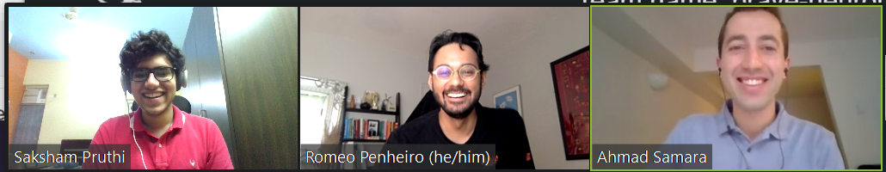
Brain Activity and Functional Connectivity during Working Memory Task
Ahmad Samara, Romeo Penheiro, Saksham Pruthi
Ishani Ganguly (Pod TA), Dr. Jonathan Wirsich (Project Mentor), Nicholas Blauch (Project TA)
Pod name: partial-cows
Team name: brave-neurons

Slide 2
Research Questions and Data
Our Questions:
Which brain regions are most important for the 2-back working memory task? (answered)
What are the connectivity patterns during task within regions regions with highest activity? (answered)
How well can we predict WM performance using averaged FC values at the whole-brain level vs. within top regions? (answered)
Dataset:
Human Connectome Project (2020) - fMRI data from 339 subjects (321 subjects for t-test)
Parcellated cortical regions, 180/hemisphere (Glasser et al., 2016)
Working Memory Task:
Recognize images that were just presented (0-back) or were presented two images ago (2-back)

Slide 3
Approach for Planned Analyses and Modelling
Average activity during the 0-back was subtracted from the 2-back task across the brain regions to identify the regions with the highest activity
Regions with the contrast analysis during working memory task was determined by contrast analysis and verified by statistical t-test using beta values from a GLM
Networks consisting of these regions was used to compute the patterns of functional connectivity (FC) during the task
We calculated the correlation between average FC values and performance (median response times) in the WM task
Describe FC patterns within other ROIs (i.e., Default Mode Network) and correlate with performance

Slide 4
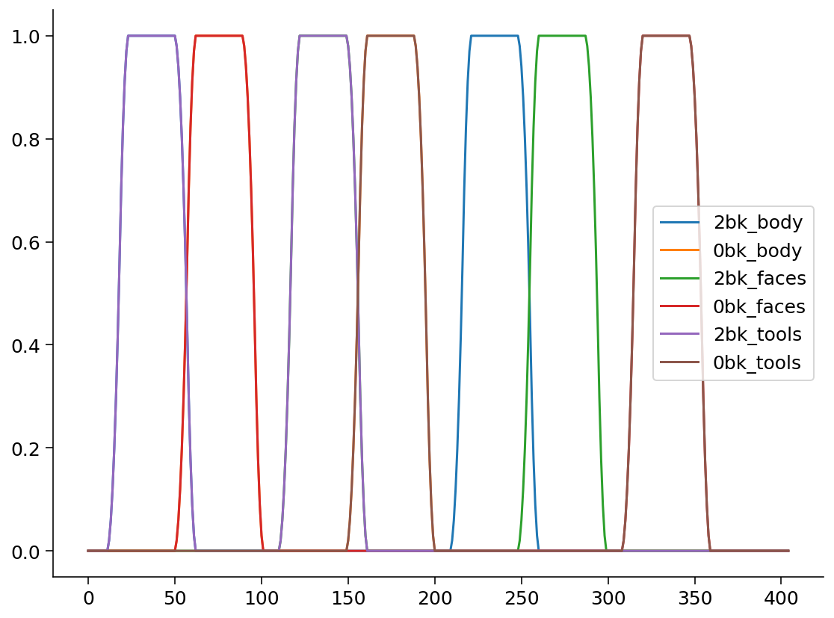
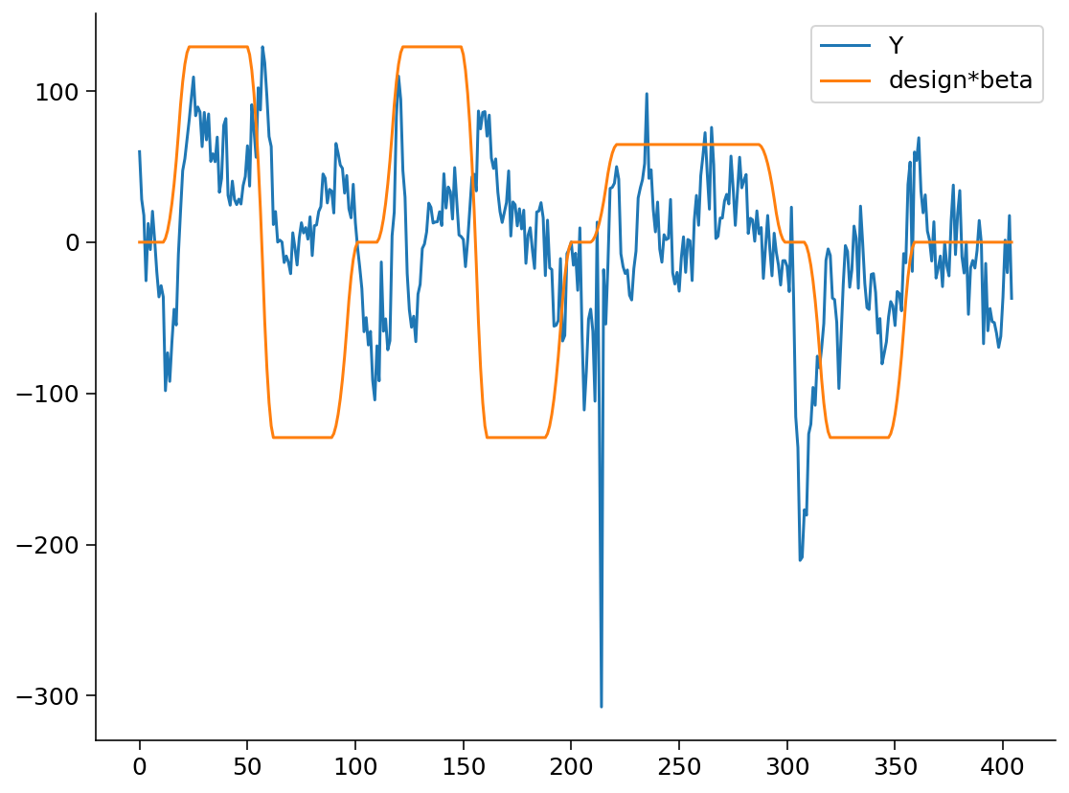
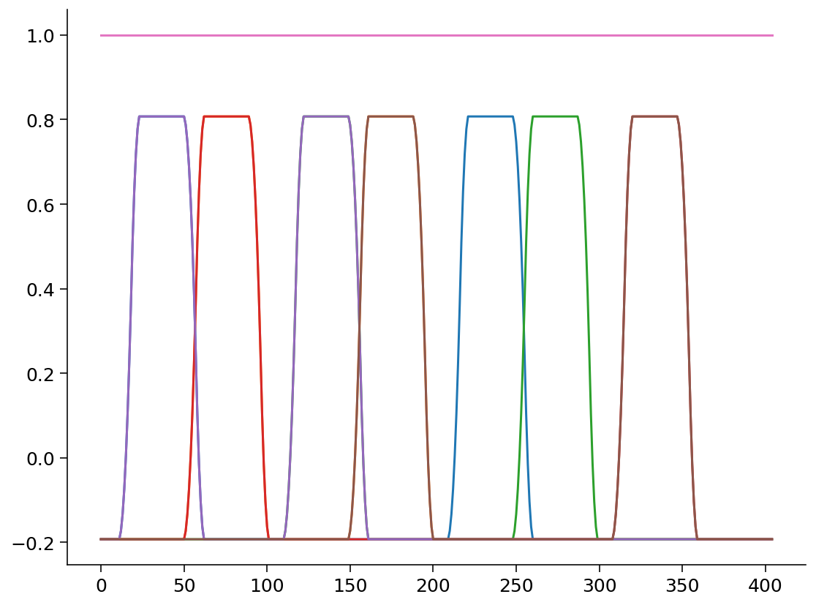
Results
1. GLM to regress working memory stimulus (2bk v/s 0bk) against fMRI time series convolved with HRF and used beta-values to determine regions which respond to Working Memory task

Slide 5
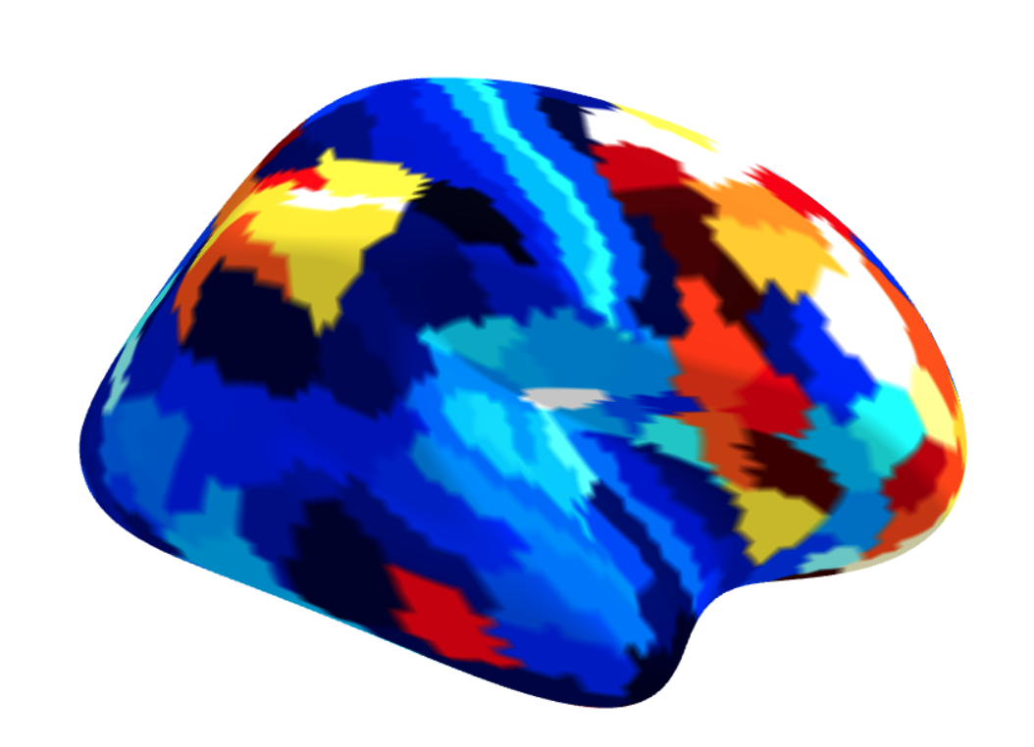
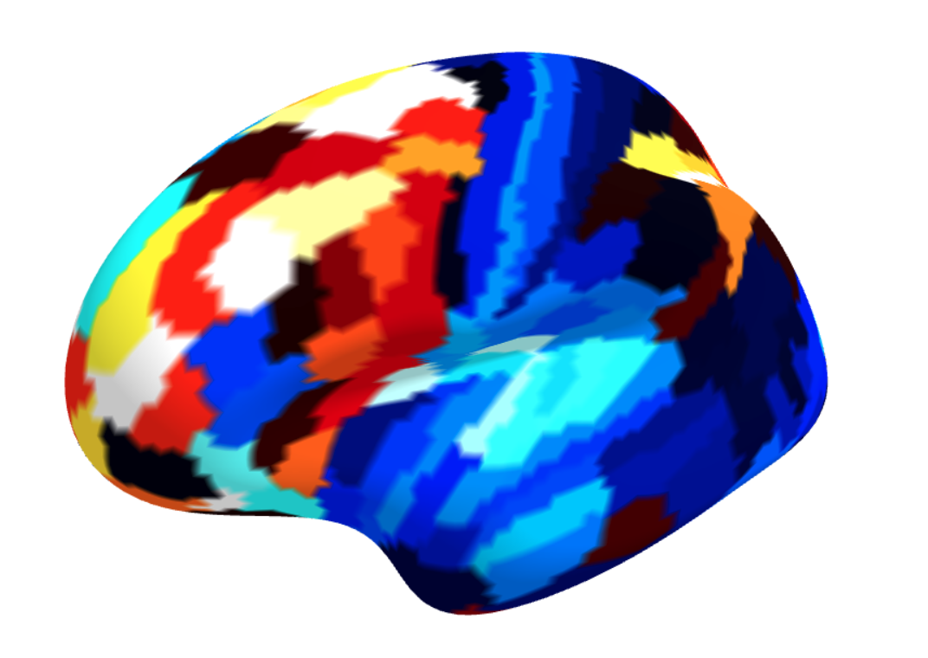
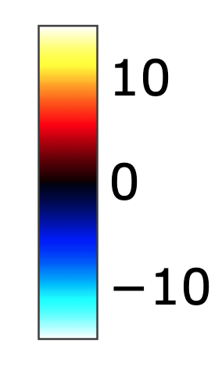
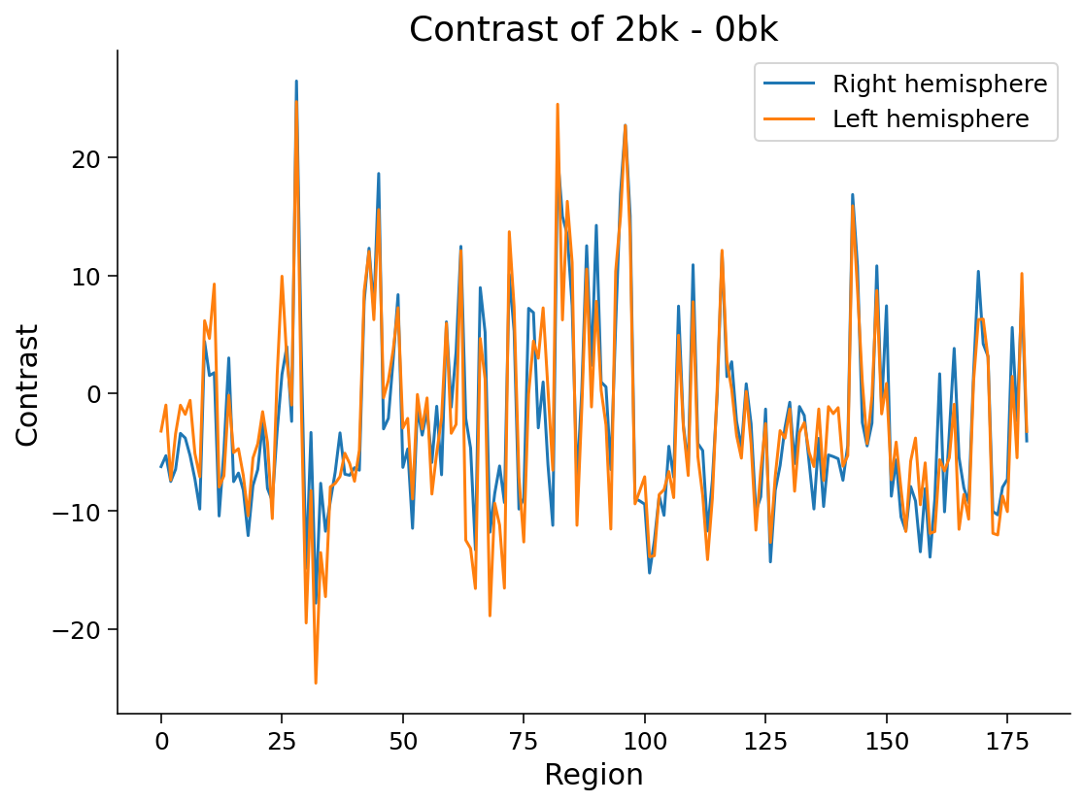
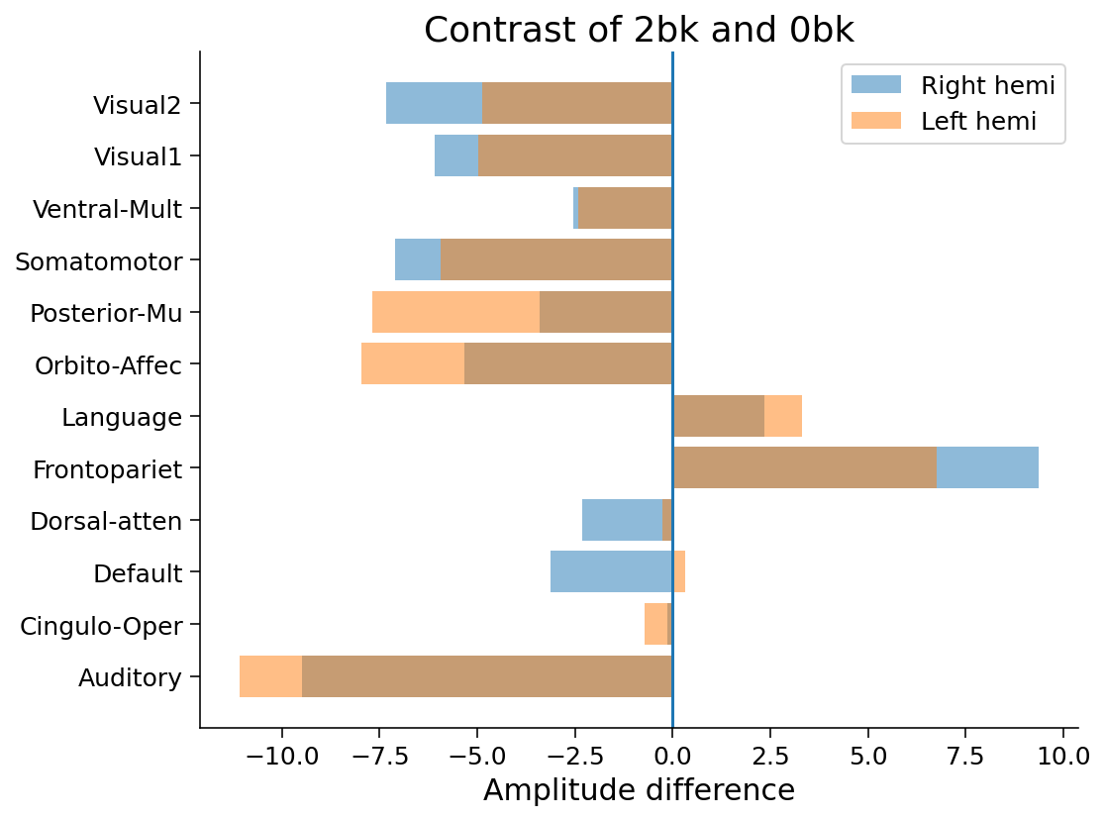
Results
2. Activity in brain regions and networks

Slide 6
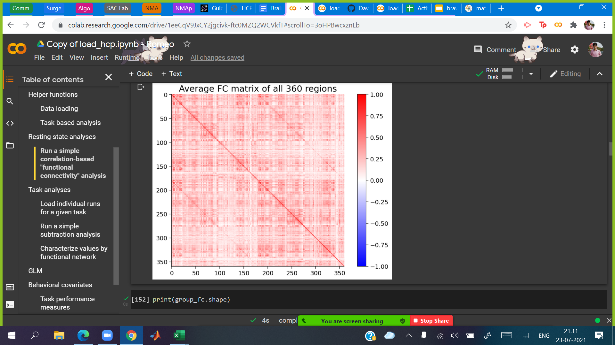
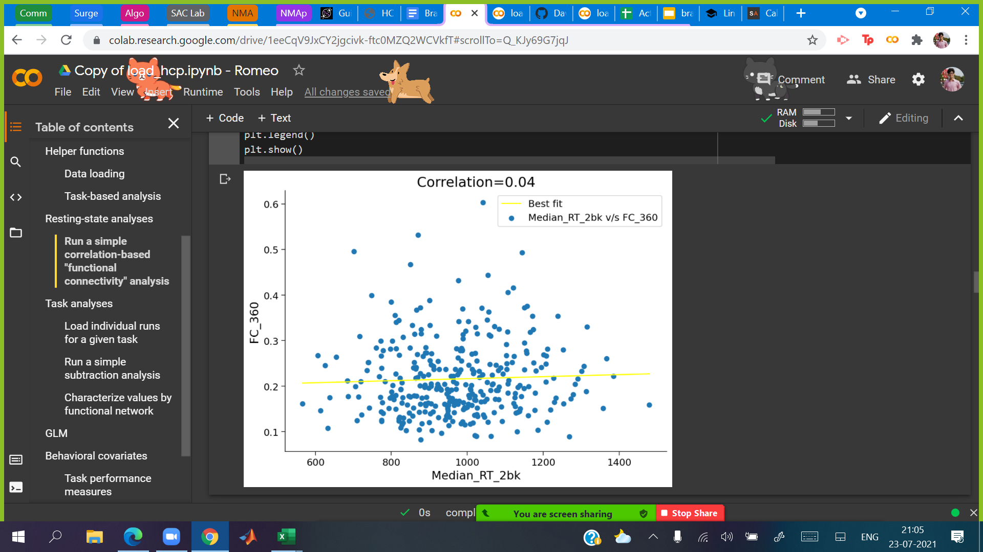
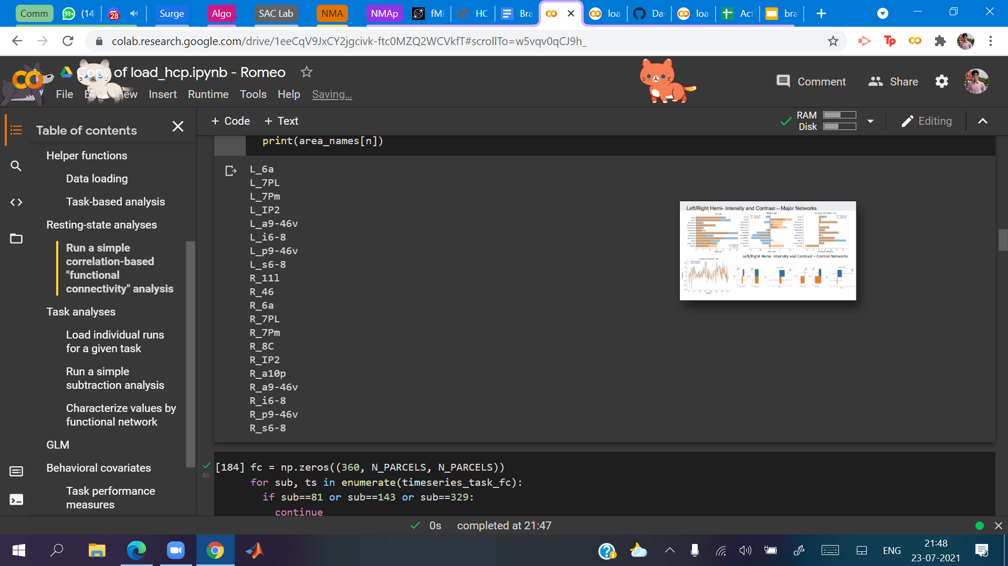
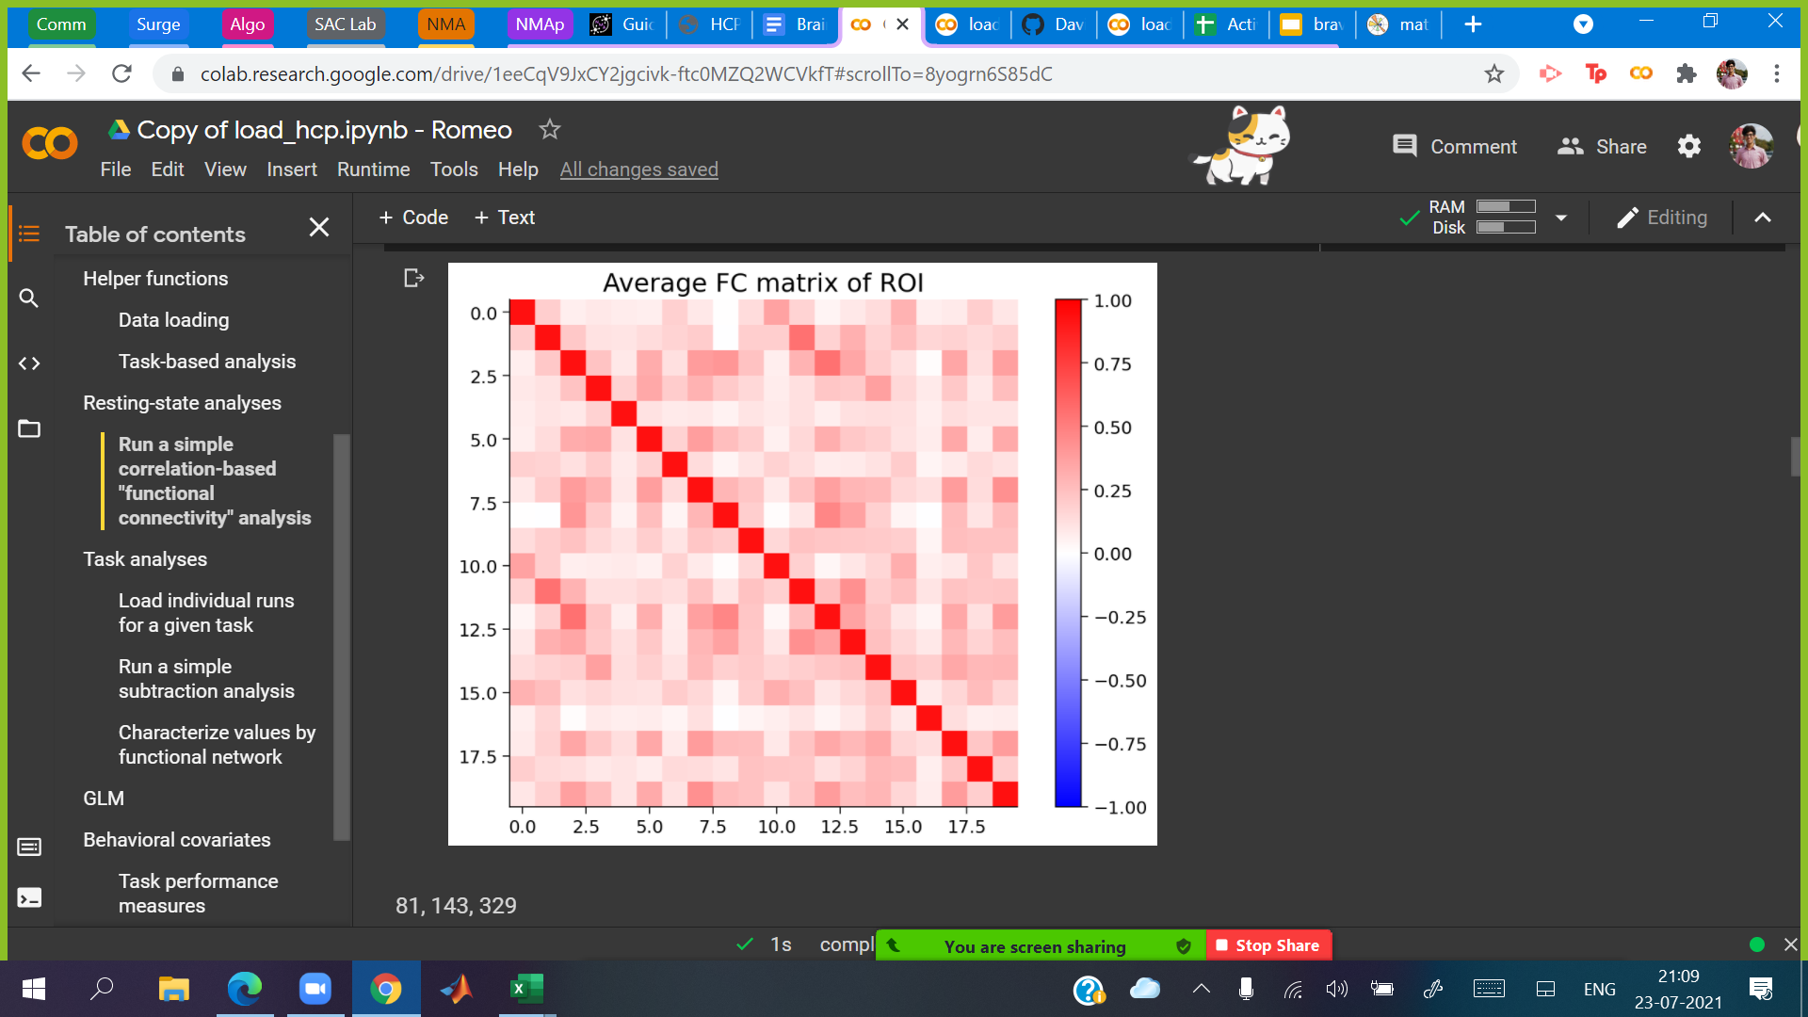
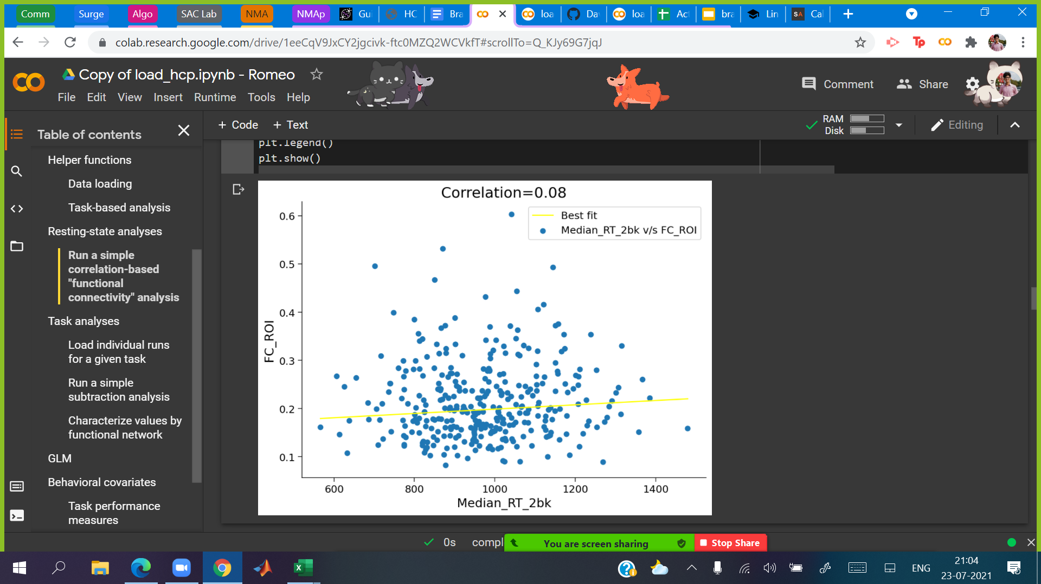
Results
3. Functional Connectivity:
Whole-brain level vs. top 20 regions
Correlation with performance (median response time)

Slide 7
Future work
Describe FC patterns within other ROIs (i.e., Default Mode Network, Multi-Modal networks) and correlate or anti-correlate with performance
(Applying approaches with higher sophistication for a better insight for predicting task performance using Functional Connectivity)

Slide 8
References
Glasser, M. F., Coalson, T. S., Robinson, E. C., Hacker, C. D., Harwell, J., Yacoub, E., Ugurbil K., Andersson, J., Beckmann, C. F., Jenkinson, M., Smith, S. M., & Van Essen, D. C. (2016). A multi-modal parcellation of human cerebral cortex. Nature, 536 (7615), 171-178.

